Slide 1

Rental Prices in NYC by airbnb
Examining the price variability: How do different variables impact the price of an airbnb rental in NYC? (neighborhood and room type)
Examining rental availability by neighborhood: Which neighborhoods have the largest market share?

Slide 2
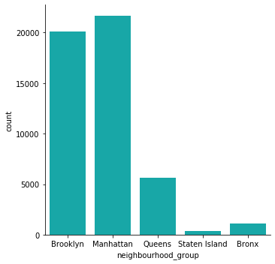
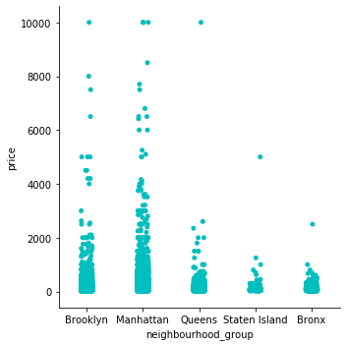
Data Exploration – Neighborhoods
Count of listings per room type
Listing price by room type

Slide 3
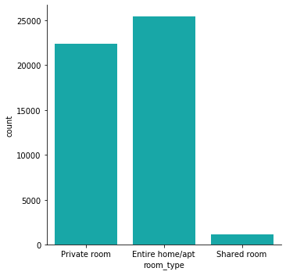
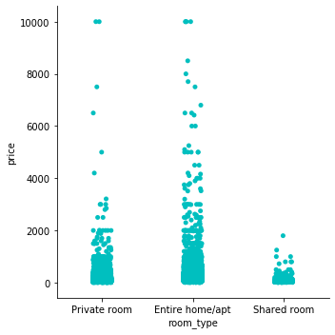
Data Exploration – Room Type
Count of listings per neighborhood
Listing price by neighborhood

Slide 4
Outliers
Statistics (Price)
Count | 48895
Mean | 152.72
Std | 240.15
min | 0
25% | 69
50% | 106
75% | 175
Max | 10,000
Initial data exploration has identified outliers in price.
The maximum value does not match the other price point statistics
Additional research is needed to determine why there are such outliers and to remove outliers from future analysis to answer questions about NYC airbnb

Slide 5
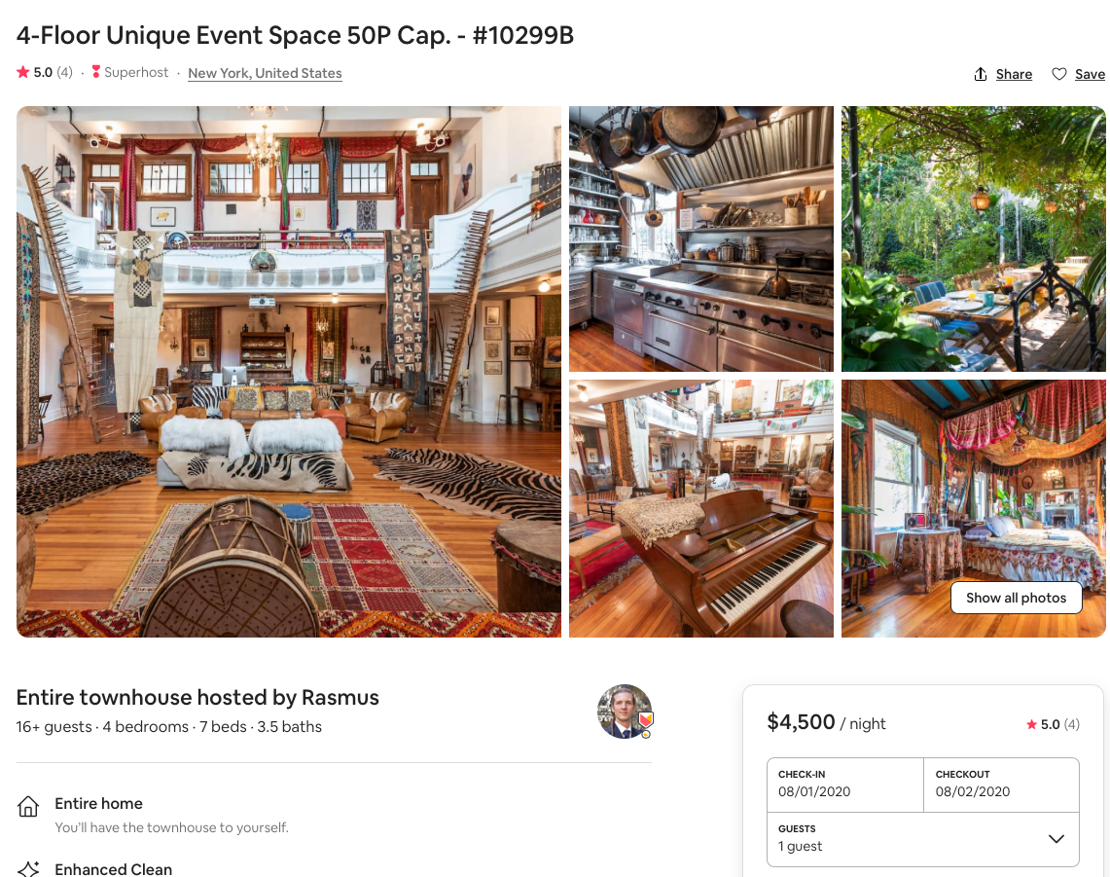
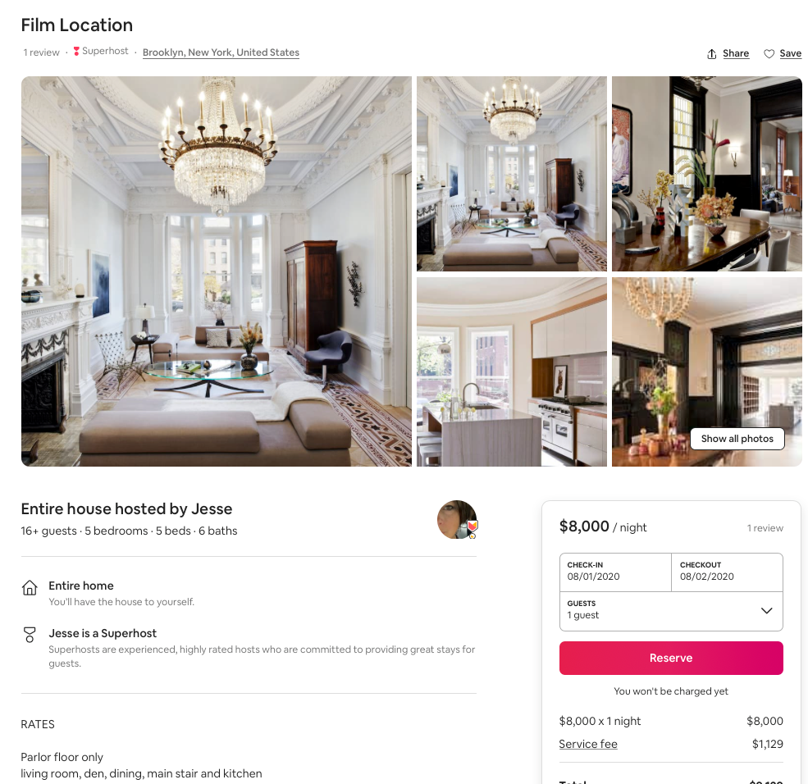
Outliers – special events
Private Event Spaces
Film Locations

Slide 6
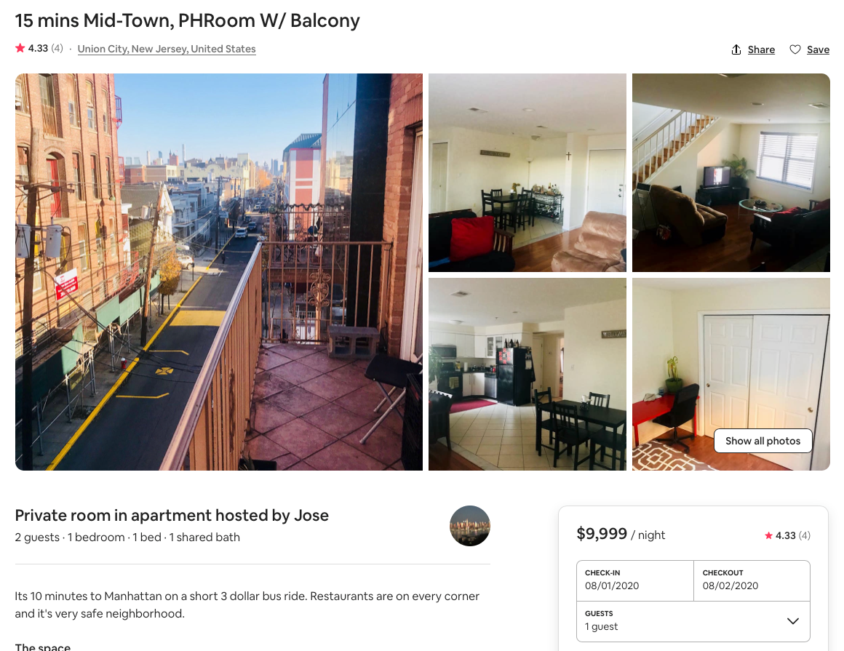
Outliers – Pricing Errors

Slide 7
Outliers Removed
Updated Statistics (Price)
Count | 46,216
Mean | 133.16
Std | 84.53
min | 36
25% | 70
50% | 108
75% | 175
Max | 499
Updated price statistics after removing the bottom 2.5% and top 2.5%
Count changed from 48,895 to 46,216
Mean changed from 152.72 to 133.16
Standard Deviation changed from 240.15 to 84.53
Min changed from 0 to 36
25% changed from 69 to 70
50% changed from 106 to 108
75% remains the same at 175
Max changed from 10,000 to 499
Removing outliers has left us with a database of listings more appropriate for the average traveler to NYC

Slide 8
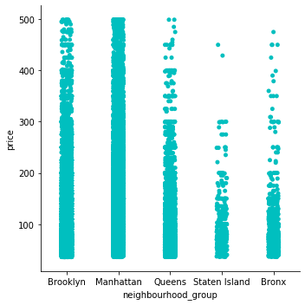
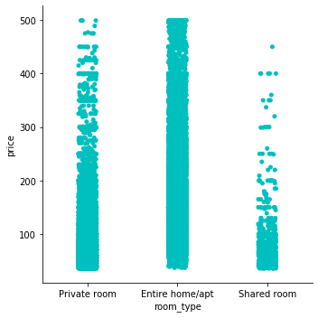
Updated Database
Prices by Neighborhood
Prices by Room Type

Slide 9
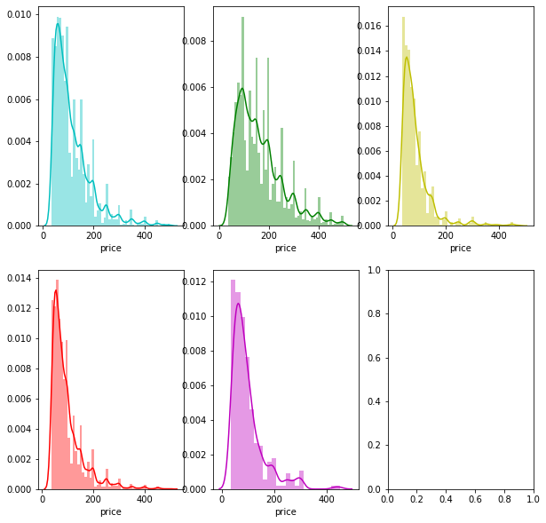
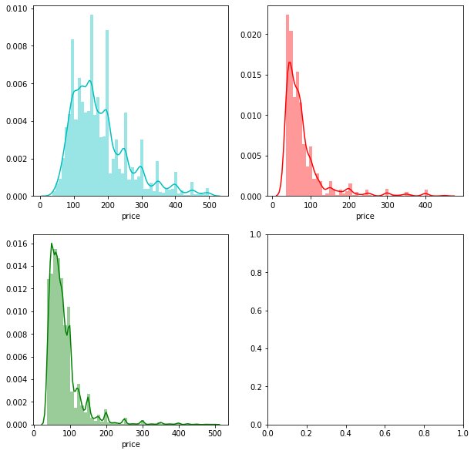
Price Distributions (outliers removed)
Neighborhoods (add labels)
Room Type (add labels)

Slide 10
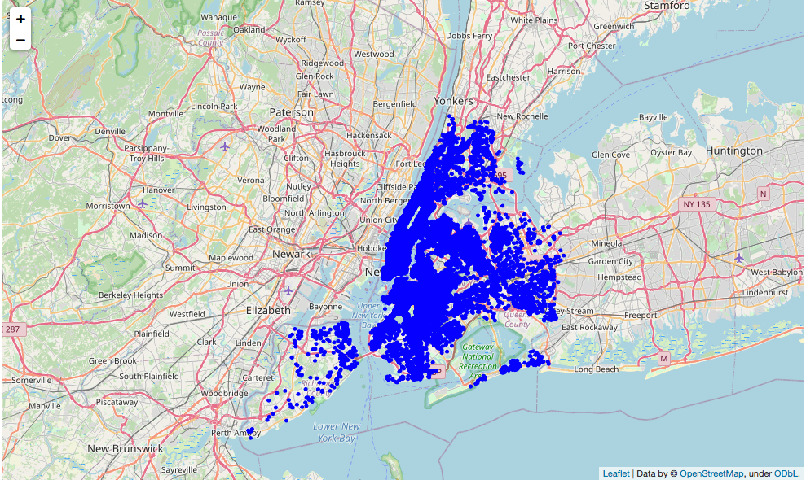
Examining NYC Neighborhoods

Slide 11
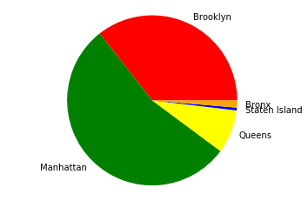
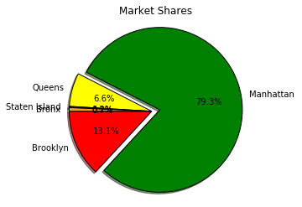
Which NYC Neighborhood has the greatest market share?
Price and Neighborhood
Number of Hosts

Slide 12
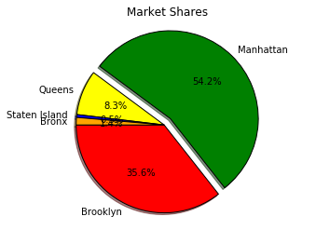
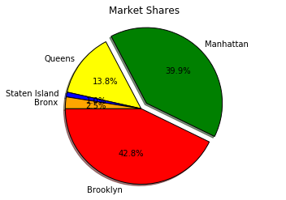
Conclusion Needed
Market Share by Neighborhood
Unknown Pie

